Slide 1

RUNGTA COLLEGE OF DENTAL SCIENCES & RESEARCH
TITLE OF THE TOPIC-ENDODONTIC MISHAPS
DEPARTMENT OF – CONSERVATIVE DENTISTRY AND ENDODONTICS

Slide 2
Specific learning Objectives
At the end of this presentation the learner is expected to know ;
Core areas* | Domain ** | Category #
Introduction | Cognitive | Must know
Method | Psychomotor | Must know
Armamentarium | Cognitive | Must know
*Subtopic of importance
** Cognitive, Psychomotor or Affective
# Must know , Nice to know & Desire to know
( Table to be prepared as per the above format )

Slide 3
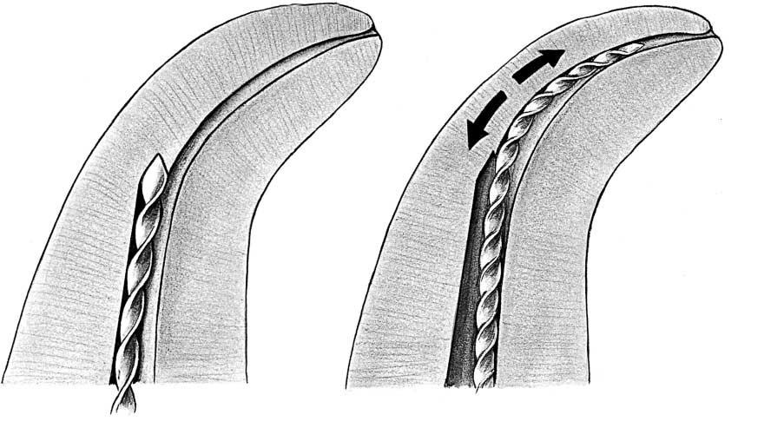
Contents
Introduction
Definition
Classification
Access related
Instrumentation related
Obturation related
Miscellaneous
Conclusion

Slide 4
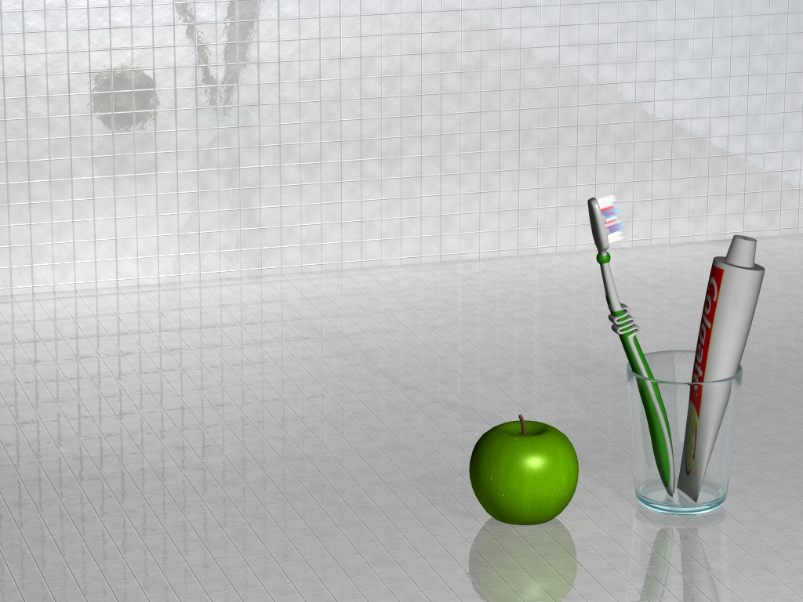
Endodontic Mishaps

Slide 5
Definition
Those unfortunate occurrences that happen during treatment, some owing to inattention to detail, others totally unpredictable (Ingle)
Unwanted or unforeseen circumstances during root canal therapy that can affect the prognosis.
(Walton & Torabinejad)

Slide 6
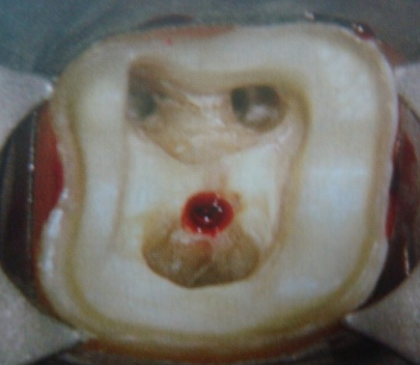
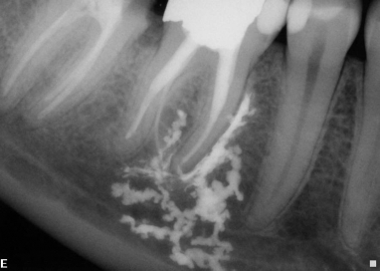
Classification
A) Acc. to Walton & Torabinejad
I) Procedural accidents& shaping
Ledge formation
Creating an artificial canal
Root perforations
during access preparation
II) Accidents during cleaning Separated instruments
Other accidents
III) Accidents during obturation
Underfilling
Overfilling
Vertical root fractures
IV) Accidents during post space preparation

Slide 7
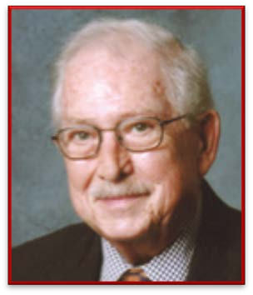
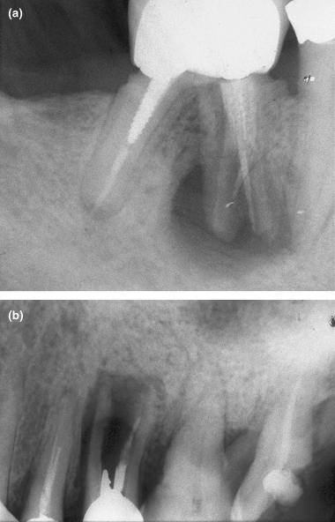
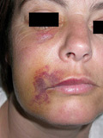
B) Acc to Ingle:
Access related
  Treating the wrong tooth
  Missed canals
  Damage to existing restoration
  Access cavity perforations
  Crown fractures
II. Instrumentation related
  Ledge formation
  perforations
  Separated instruments and foreign objects
  Canal blockage

Slide 8
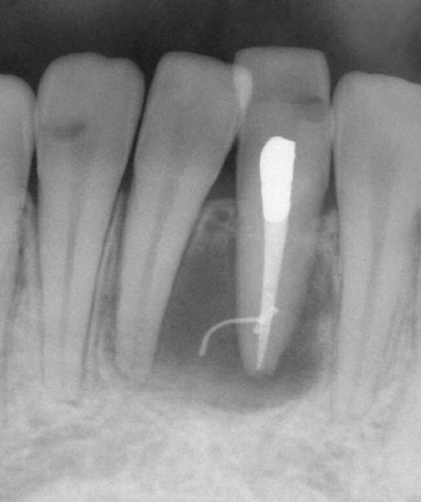
III. Obturation related
  Over- or under extended root canal fillings
  Nerve paresthesia
  Vertical root fractures
IV. Miscellaneous
  Post space perforation
  Irrigant related
  Tissue emphysema
  Instrument aspiration and ingestion

Slide 9
C) According to Leif Tronstad (Clinical Endodontics)
Access cavity
Perforations from the pulp chamber
Root Perforations
    Apical perforations
    Lateral perforation
    Post-perforations

Slide 10
Fracture of an instrument
Adverse reactions to medicaments
    Local tissue irritation
    Neurotoxic reactions
    Allergic reactions
    Overfilling of the root canal
    Vertical root fractures

Slide 11
Management of a mishap
Recognition
Correction
Re-evaluation of prognosis
According to Cohen these iatrogenic events may be reduced by
3 *T* s
Training
Technique
Technology

Slide 12
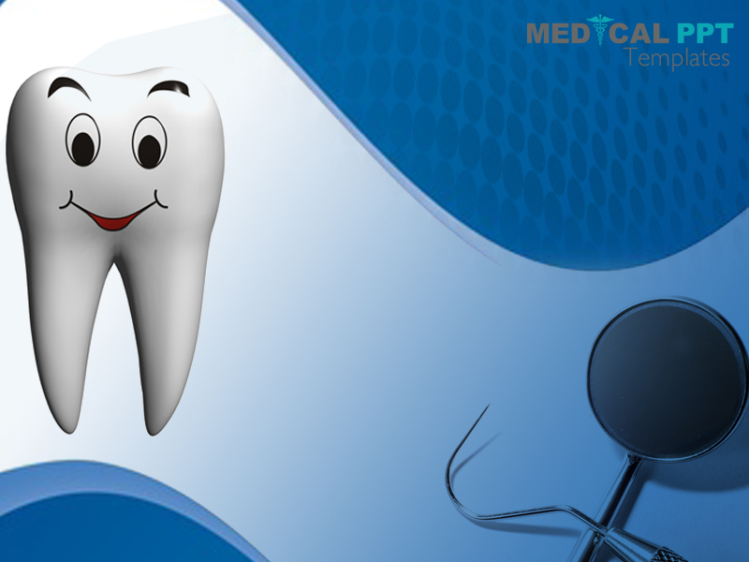
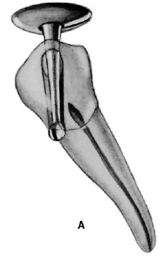
Access related mishaps

Slide 13
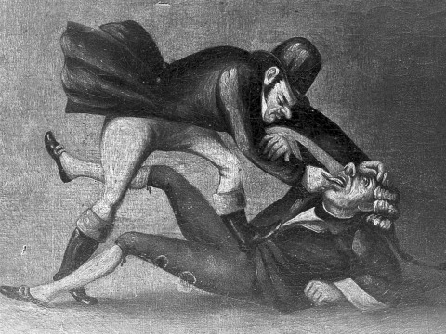
Treating the wrong tooth
Cause:
Inattention
Misdiagnosis
Recognition:
Continuation of symptoms
After the rubber dam has been removed.
Correction:
Appropriate treatment of both teeth.
  The one incorrectly opened
  The one with the original pulpal problem

Slide 14
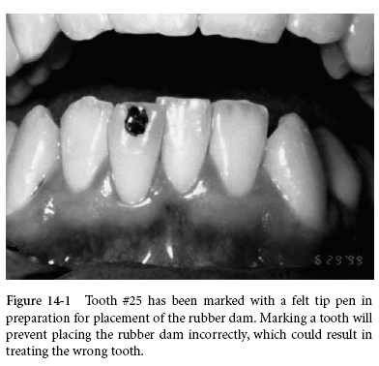
Prevention:
Obtaining as much information as possible
Marking the tooth to be treated with a pen before isolating with Rubber dam

Slide 15
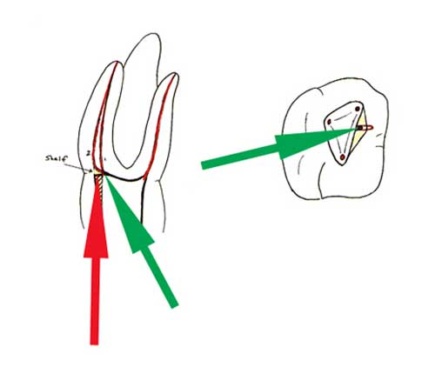
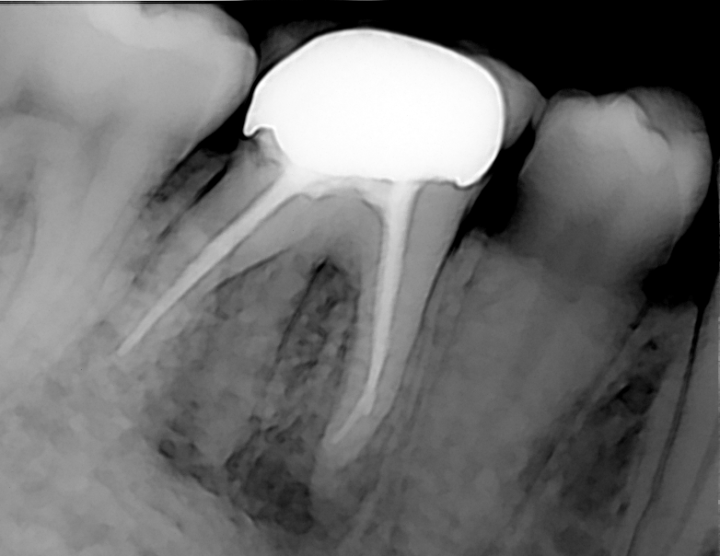
Missed canals
Cause
Anatomical
-Some root canals are not easily accessible or readily apparent
Dentist related
- Lack of knowledge about root canal anatomy
-Failure to adequately search for these additional canals.
E.g. : Mesial roots of max. molars and distal roots of mandibular molars

Slide 16
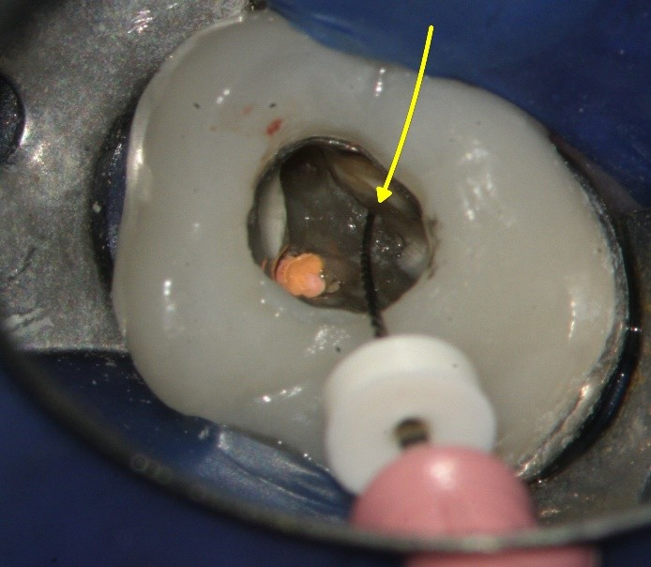
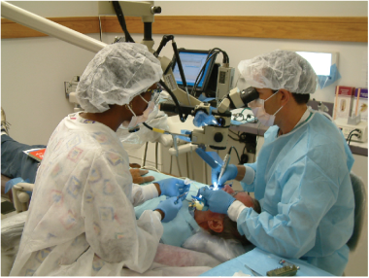
Recognition:
During treatment
An instrument or filling material -other than exactly centered in the root- another canal is present.
High resolution magnification – magnifying loupes, microscope, endoscope
NaOCl can be used to detect canals – effervescence test
Post-treatment
Correction:
Re-treatment
Prognosis:
Decreased

Slide 17
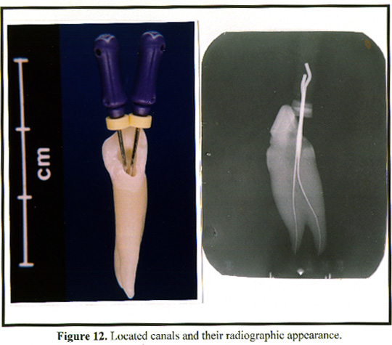
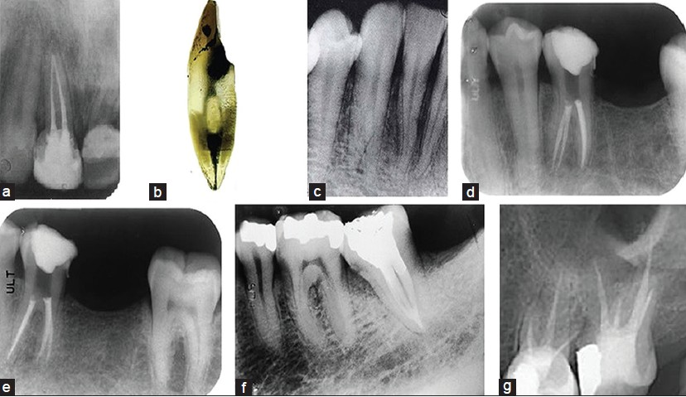
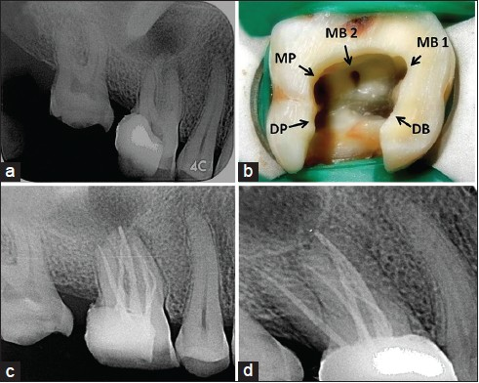
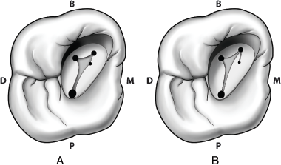
PREVENTION –
1) Knowledge
Prognosis is reduced - most likely result in treatment failure.
Common variations are..
Maxillary central incisors - one or more extra canal.
Maxillary first bicuspids - may be 3 rooted having MB, DB and palatal canals.
Maxillary second bicuspids - deep canal divisions or multiple apical portals of exit.
Maxillary 1st molar – MB2
Mandibular incisors- lingual canal 45% of time.
Mandibular premolars - frequently hold complex root canal systems.
Mandibular- 1st and 2nd - 2 canals in distal root
C – shaped canal in molars
Notes:
So the clinician must be thorough with normal anatomy and variations in canal anatomy

Slide 18
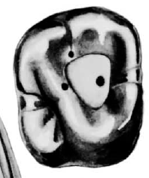
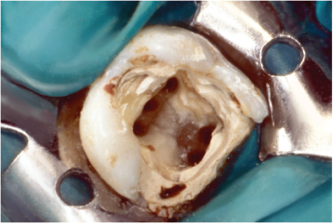
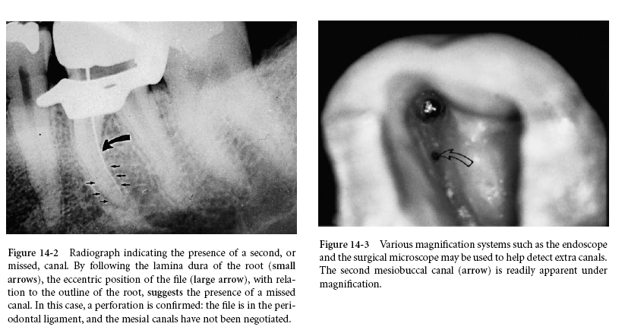
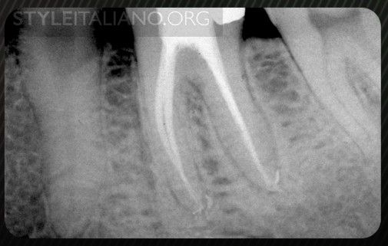
2) Access -
3) Radiographs

Slide 19
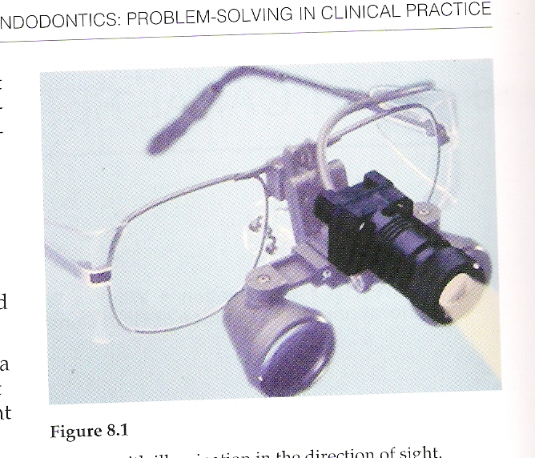
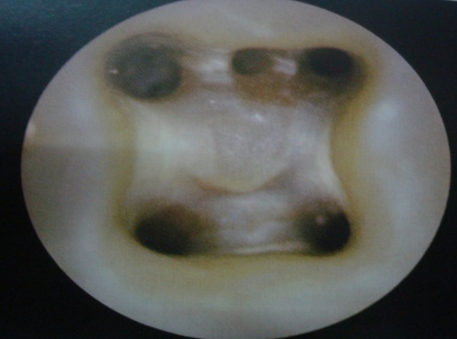
4) Using magnifying loupe, microscope, dyes, ultrasonics
5) Sodium hypochlorite can aid in the diagnosis of missed or hidden canals by means of the effervescence test ‘champagne bubble’ test
6) Troughing Methods: Using the “WHITE LINE TEST”
Notes:
The CT- 4 is used to create the initial troughing groove to locate an MB 2 canal. The CT – 4 is used in a etching, back and forth action with the water turned off. The assistant applies a steady stream of air to the trough, any pulp tissue present becomes desiccated and turns white. The white line is a virtual road map to the missed canal.

Slide 20
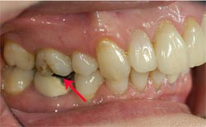
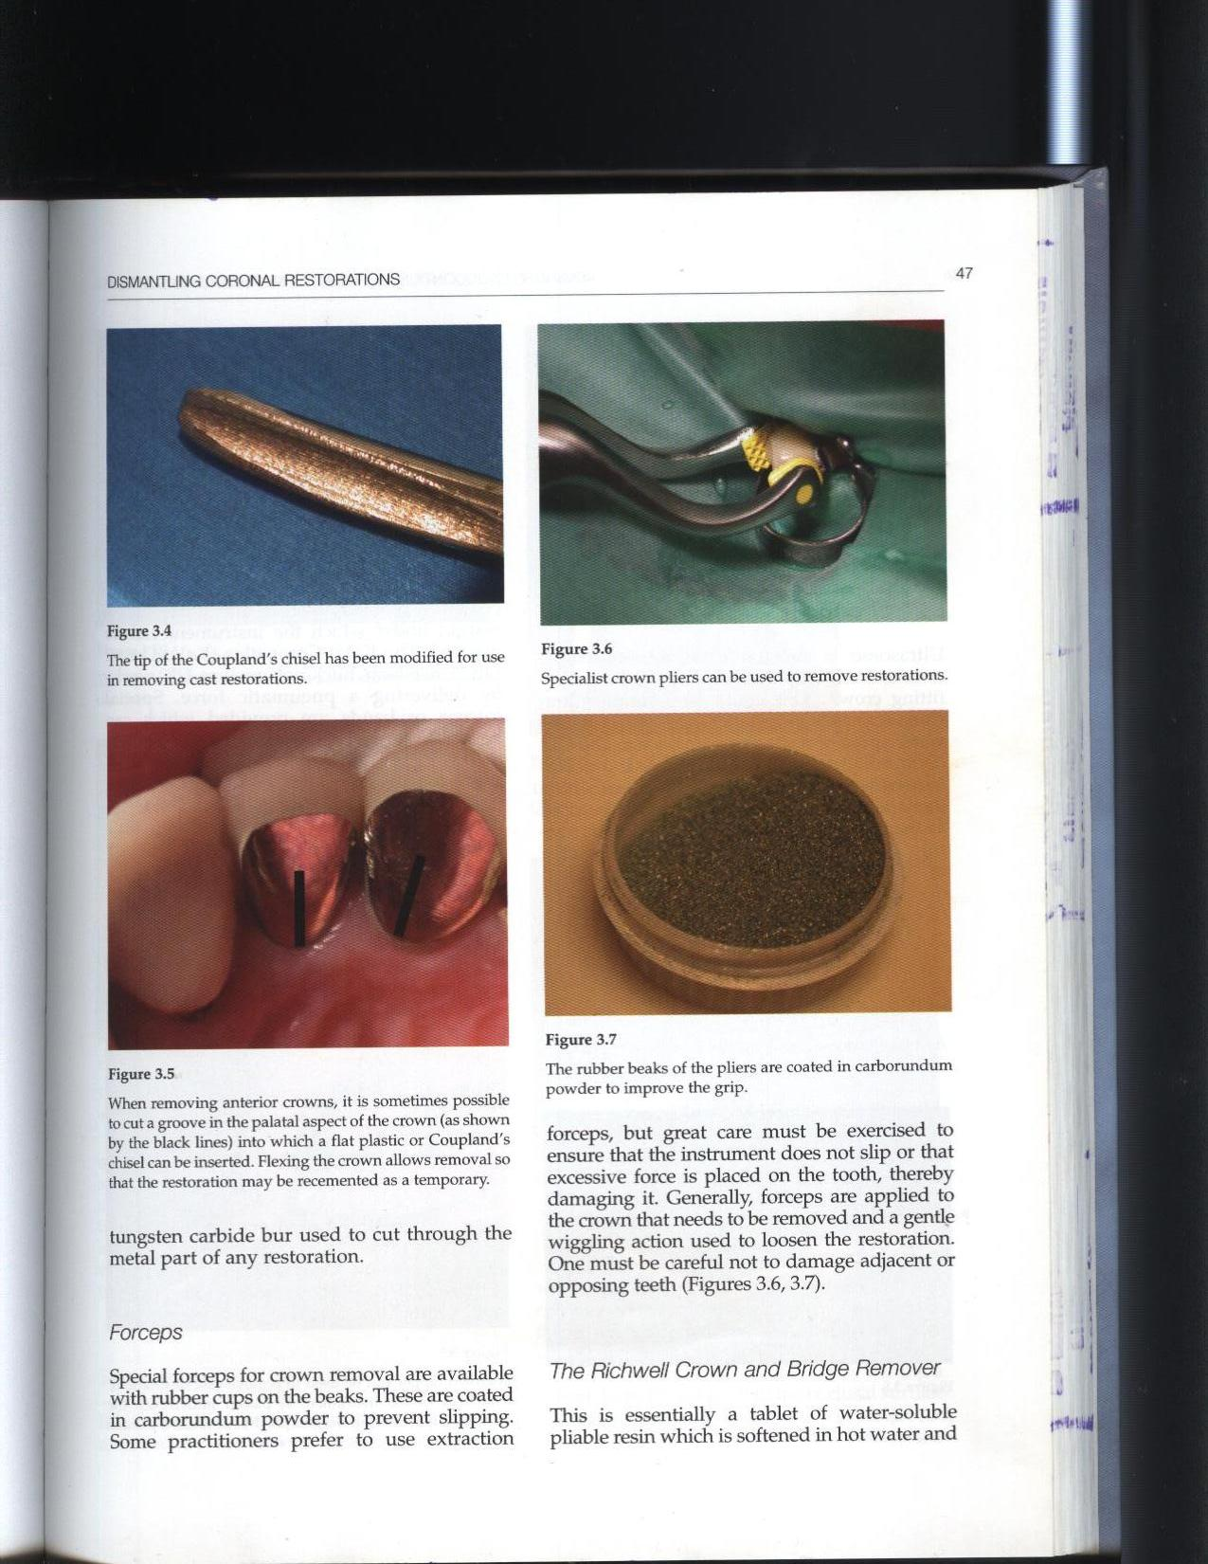
Damage to existing restoration
Endo-treatment of a tooth with existing porcelain crown is challenging.
Crown may chip off even with the most careful approach
  While preparing access cavity
  Placing rubber dam clamp on the margins
Correction:
Bonding composite resin to the crown.
Prevention :
Avoiding placing clamp directly on the margin
Remove permanently cemented crown before treatment
Specialist crown pliers can be used to remove restorations

Slide 21
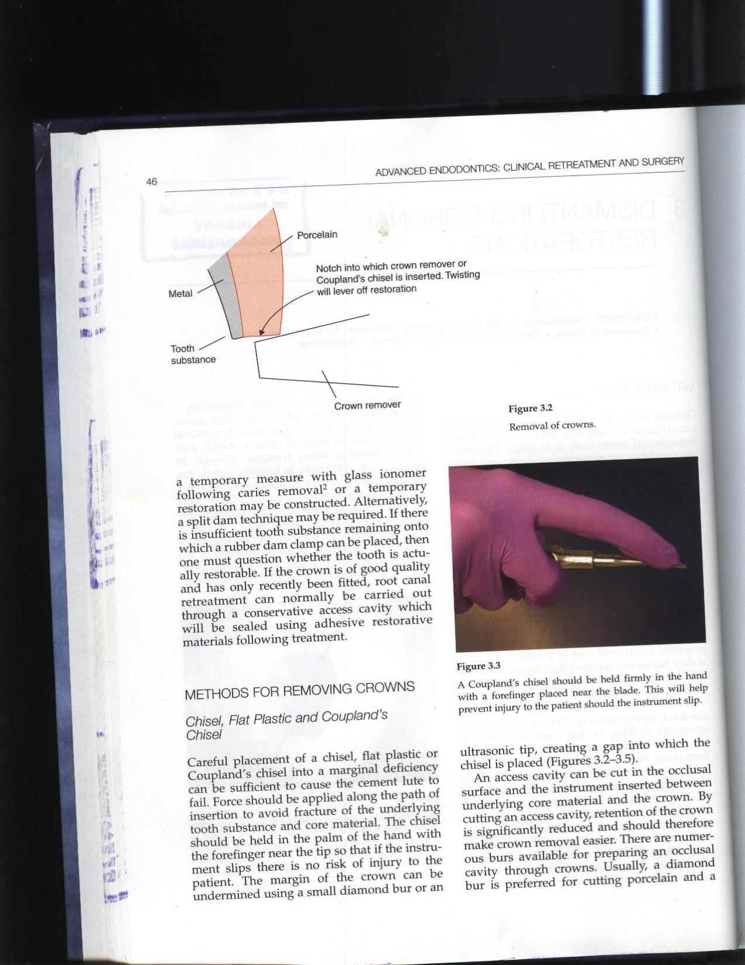
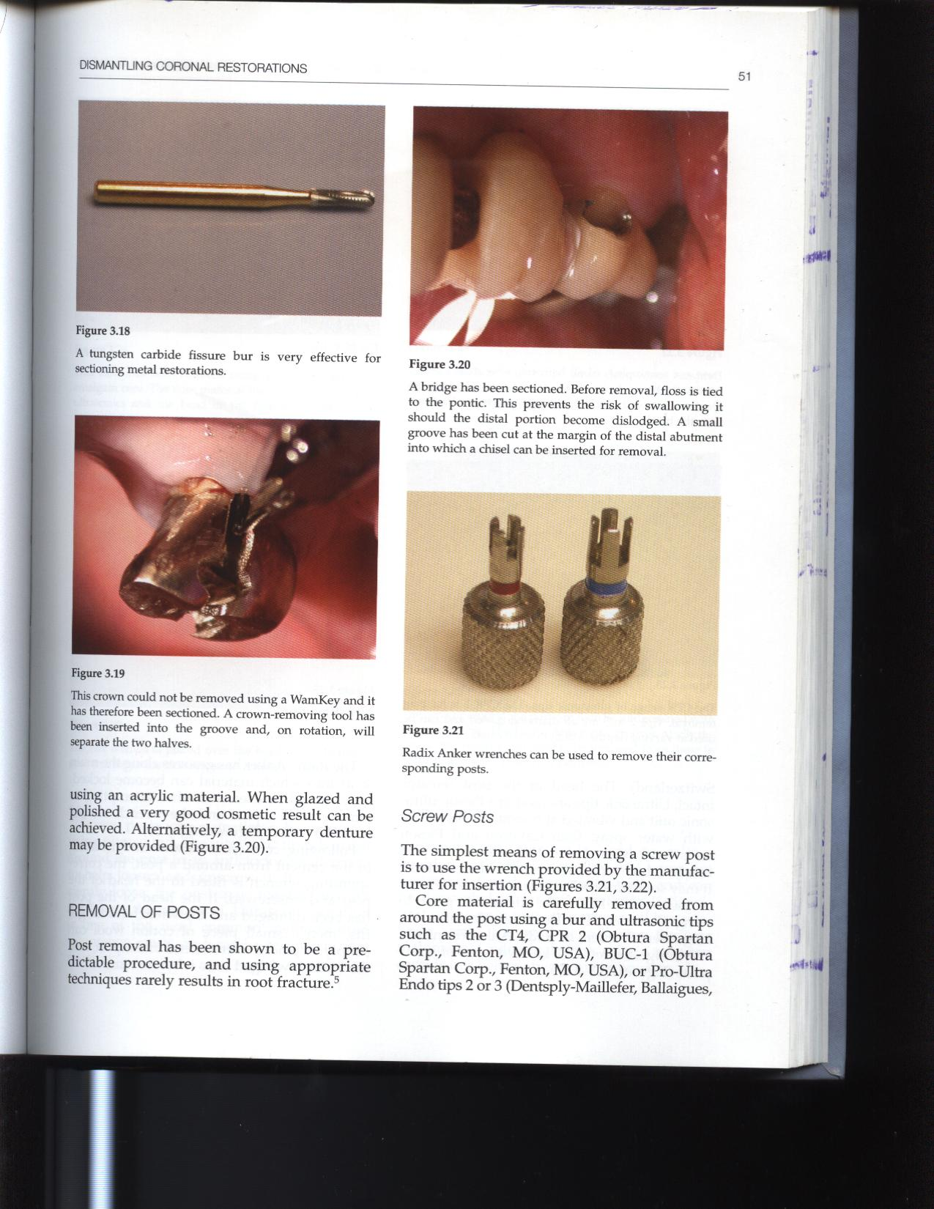
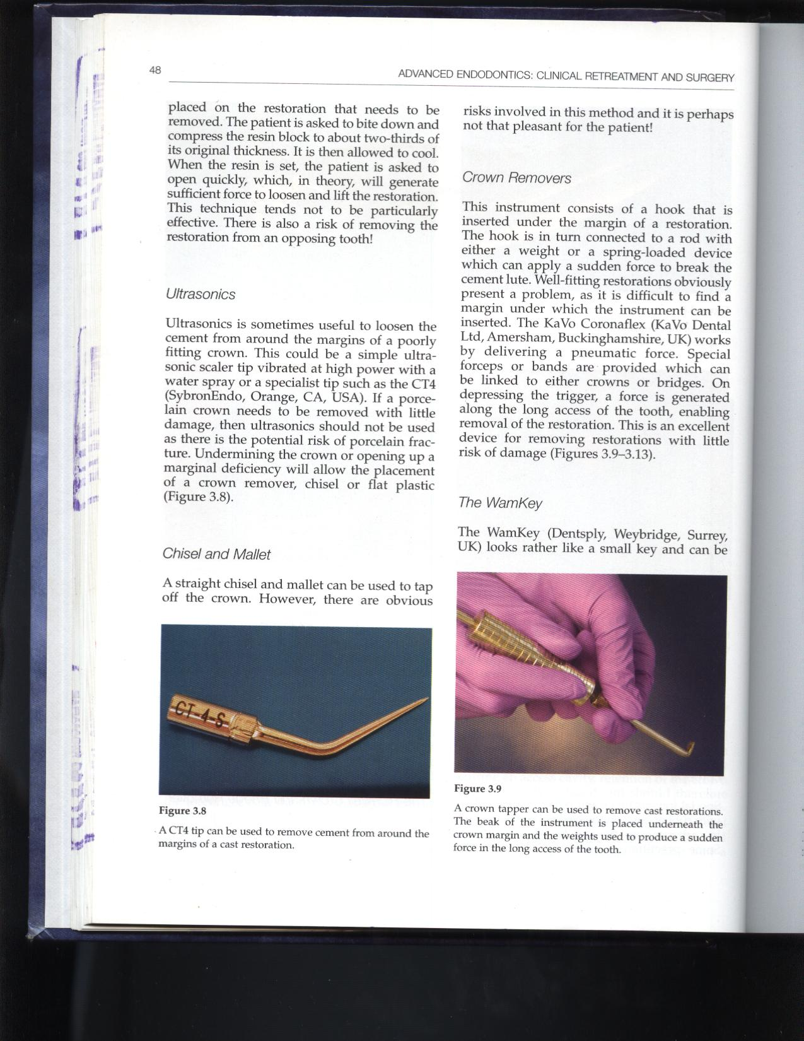
Other methods
Remove crown with special device called Metalift crown and bridge system
A Coupland's chisel should be held firmly in the hand with a forefinger placed near the blade
Sectioning
A C -T4 tip can be used to remove cement from around the margins of a cast restoration.

Slide 22

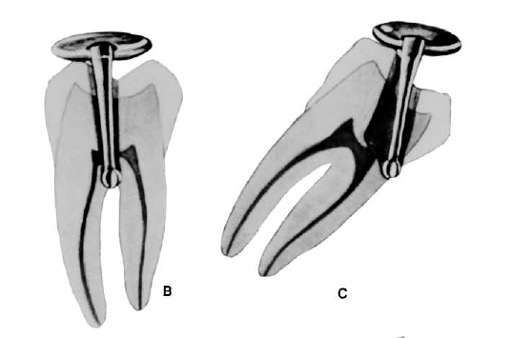
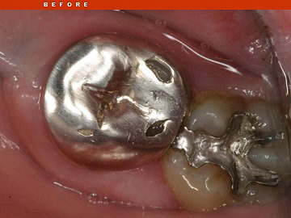
Access cavity perforations
Undesirable communications between the pulp space and the external tooth surface
Happens during the search for canal orifices.
Can occur either peripherally through the sides of the crown or through furcation.
Crown perforations : laterally / furcation
Cause :
1. Failure to identify the angle of the crown to the root and the angle of the tooth in the dental arch.
Maxillary lateral incisors and mandibular first premolars.
Access through crowned teeth.

Slide 23
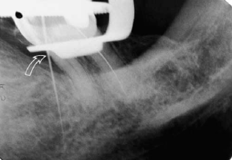
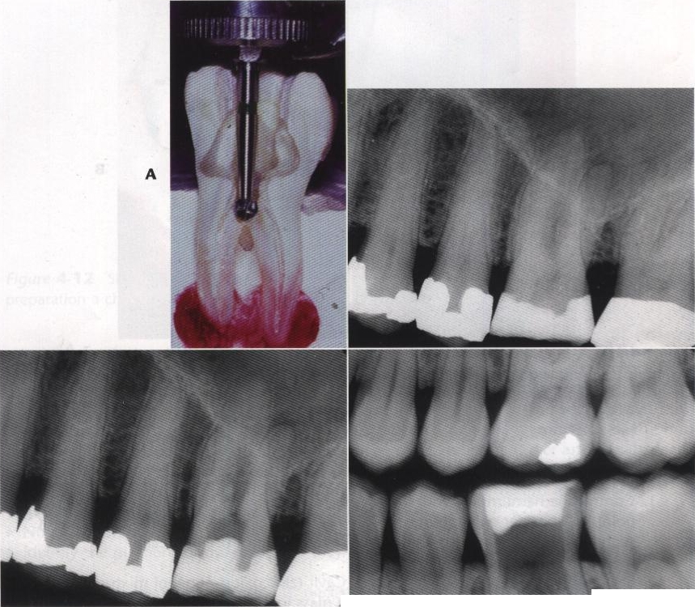
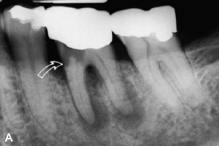
Recognition
If the access cavity perforation is
Above PDL attachment
Presence of leakage into the access indication of an accidental perforation.
Into PDL
  Bleeding into the access cavity is often the first indication of an accidental perforation.

Slide 24

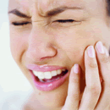
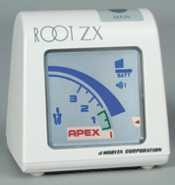
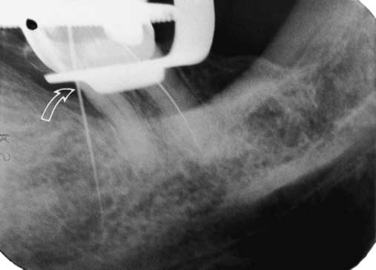
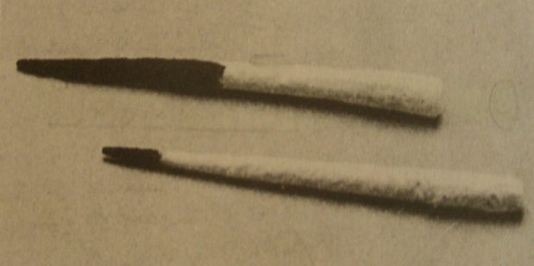
Other methods for Recognition:
Bleeding
Pain
Leakage
Apex locator
Radiograph
Paper point

Slide 25
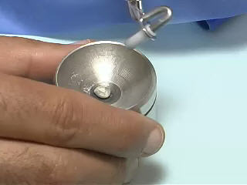
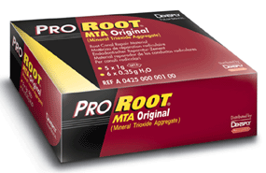
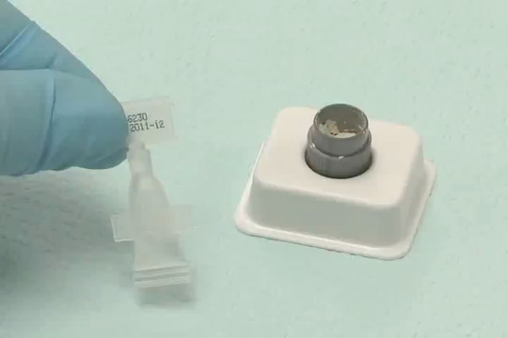
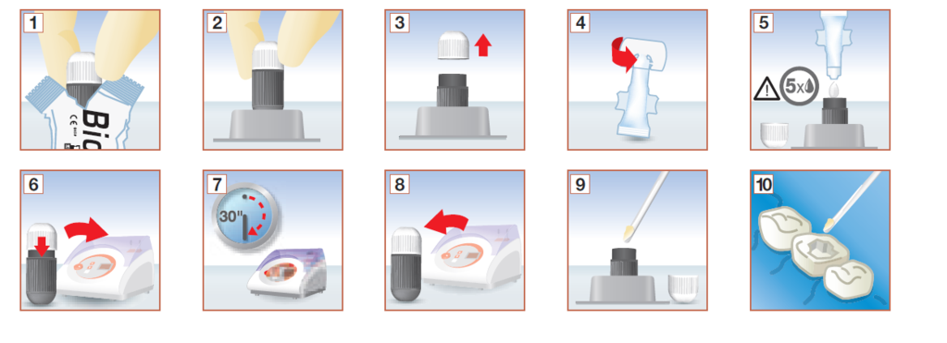
Correction
Amalgam
Calcium hydroxide paste
Super EBA
Glass ionomer cement
Gutta-percha
Tricalcium phosphate
IRM
Mineral trioxide aggregate (MTA)
Biodentine

Slide 26
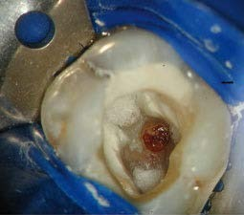
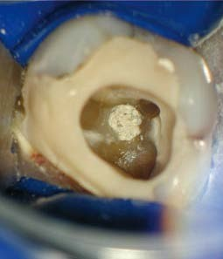
Correction
Coronal walls above the alveolar crest – can be repaired intracoronally without surgical intervention.
Perforations into periodontal ligament – should be done as early as possible to minimize injury to the tooth’s supporting tissues.
Materials used for these perforations
- GIC, MTA, Biodentine,Super EBA, Tricalcium phosphate, Calcium hydroxide paste, amalgam or haemostatic agents such as gel foam.
Study by Alhadainy and Abdalla
MTA and Biodentine, used as barriers, significantly improved sealing ability of vitrebond and provide successful barriers against its overextension.

Slide 27
PREVENTION
Proper bur alignment with the long axis of the tooth
Bur penetration for both depth and angulation can be confirmed with radiographs
Knowledge about the morphology
Adequate access preparation

Slide 28
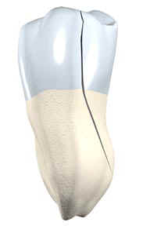
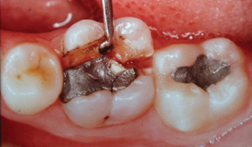
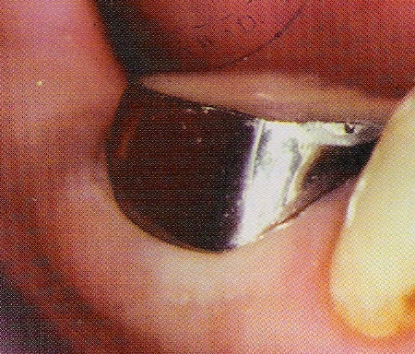
Crown fractures
Recognition
Treatment:
Circumferential bands / temporary crowns
“Chisel type” fracture
Extraction
Prognosis
Less favorable
Prevention:
Reduce the occlusion
Bands and temporary crowns
A tooth with a preexisting infraction becomes a true pain when the patient chews on the tooth weakened additionally by an access preparation.
Banding crown

Slide 29
TAKE HOME MESSEGE/ FOR THE TOPIC COVERED (SUMMARY)
Management of a mishap can be done by-
Recognition
Correction
Re-evaluation of prognosis
According to Cohen these iatrogenic events may be reduced by
3 *T* s
Training
Technique
Technology

Slide 30
Question & Answer Session
1. Describe in brief access related mishaps.
2. Methods for management of mishaps.
3. Give classification of endodontic mishaps.

Slide 31
References
Ingle JI, Bakland LK. Endodontics. 4th ed. Philadelphia:Williams and Wilkins; 1995.
Grossman LI, Oliet S, Del Rio C. Endodontics. 11th ed. Philadelphia: Lea and Febiger; 1988
Rowe AHR. Damage to the inferior dental nerve during or following endodontic treatment. Br Dent J 1983;153:306
Seltzer S, Bender IB, Turkenkopf S. Factors affecting successful repair after root canal therapy. J Am Dent Assoc 1963;67:651
Walia H, et al. Use of a hemostatic agent in the repair of procedural errors. JOE 1988;14:465.

Slide 32
THANK YOU

